Slide 1


Department of BES-1
COURSE: Data Structures using Python
COURSE CODE: 24SC1204
Topic:
BINARY SEARCH TREE
Session - 24

Slide 2



AIM OF THE SESSION
To familiarize students with the basic concept of Binary search tree
INSTRUCTIONAL OBJECTIVES
This Session is designed to:
Demonstrate the Binary search tree
Describe the operations of binary search tree
List out the strategies of binary search tree
Describe the implementation of binary search tree
Applications of BST
LEARNING OUTCOMES
At the end of this session, you should be able to:
Define binary search tree
Describe the insertion operations of binary search tree
How to traverse in BST
Summarize the concept of binary search tree

Slide 3
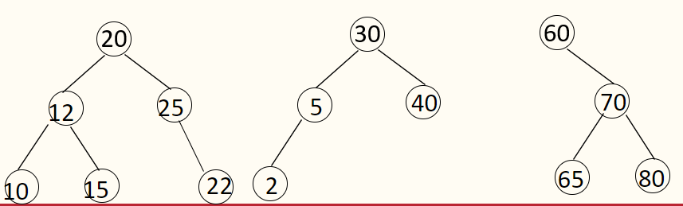
Introduction to Binary Search Tree
  It is a variant of Binary tree.
  Efficient for sorting, searching, insertion and deletion can be done.
    It is also known as ordered binary tree.
  Every node has a unique key.
  All the nodes in the left sub-tree have a value less than that of the root node. Correspondingly, all the nodes in the right sub-tree have a value either equal to or greater than the root node.
  The left and right sub trees are also binary search trees.

Slide 4
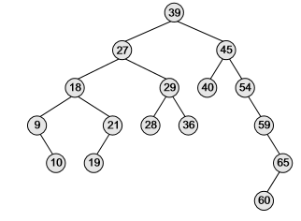
Introduction to Binary Search Tree
Example
The root node is 39
The left sub-tree nodes 9, 10, 18, 19, 21, 27, 28, 29, and 36
The right sub-tree nodes 40, 45, 54, 59, 60, and 65
Recursively, each of the sub-trees also obeys the binary search tree constraint

Slide 5
Creation of BST
BST Creation
Start at the root and compare with root.
If no root is found, insert the current node as root.
If the current node's key is smaller, move left and repeat steps with new root.
If the current node's key is larger, move right and repeat steps with new root.

Slide 6
EXAMPLES
BST Creation
Create a BST with the following elements: 8, 5, 11, 6, 13, 1, 9, 7, 3, 4
8
5
11
1
6
9
13
7
3
4

Slide 7
Operations on BST
Operations on BST
Inserting a Node
Deleting a Node
Traversal of Binary Search Tree
Searching for a Node
Finding the Smallest Node
Finding the Largest Node

Slide 8
BST Traversal
BST Traversal
By “traversal” we mean visiting all the nodes in a graph
Traversal strategies can be speciﬁed by the ordering of the three objects to visit: the current node, the left subtree, and the right subtree.
We assume the left subtree always comes before the right subtree
Then there are three strategies.
1. Inorder. The ordering is: the left subtree, the current node, the right subtree.
2. Preorder. The ordering is: the current node, the left subtree, the right subtree.
3. Postorder. The ordering is: the left subtree, the right subtree, the current node.

Slide 9
BST Traversal
Preorder Traversal Pseudocode
:
Preorder-Walk(x) :
1: if x = nil then return
2: Print key[x]
3.Preorder-Walk(left[x])
4: Preorder-Walk(right[x])
Postorder Traversal Pseudocode:
Post order-Walk(x)
1: if x = nil then return
2: Preorder-Walk(left[x])
3: Preorder-Walk(right[x])
4: Print key[x]

Slide 10
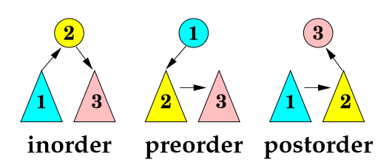
BST Traversal
Inorder Traversal Pseudocode
:
Inorder-Walk(x)
1: if x = nil then return
2: Inorder-Walk(left[x])
3: Print key[x]
4: Inorder-Walk(right[x])

Slide 11
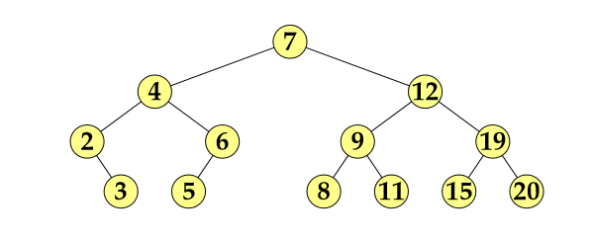
Example
What is the outcome of inorder traversal on this BST?
How about postorder traversal and preorder traversal?

Slide 12
Example
Inorder traversal : 2, 3, 4, 5, 6, 7, 8 , 9, 11, 12, 15, 19, 20.
Preorder traversal : 7, 4, 2, 3, 6, 5, 12, 9, 8, 11, 19, 15, 20.
Postorder traversal : 3, 2, 5, 6, 4, 8, 11, 9, 15, 20, 19, 12, 7.

Slide 13
DESCRIPTION (Cont..)
BST Insertion
1. Create a new BST node and assign values to it.
2. insert(node, key)
i) If root == NULL,
return the new node to the calling function.
ii) if root->data < key
call the insert function with root->right and assign the return value in
root->right.
root->right = insert(root->right,key)
iii) if root->data > key
call the insert function with root->left and assign the return value in
root->left.
root->left = insert(root->left,key)
3. Finally, return the original root pointer to the calling function.

Slide 14
BST Insertion
BST Insertion
Insert (2)
8
8
5
11
5
11
1
6
9
13
1
6
9
13
7
7
3
3
4
2
4

Slide 15
BST Insertion
BST Insertion
Insert (10)
8
8
5
11
5
11
1
6
9
13
1
6
9
13
7
7
10
3
3
2
4
2
4

Slide 16
Time Complexity
BST Insertion - Complexity
All insert operations can be supported in O(h) time.
Average Case: h = O(log n) for a balanced binary tree (and for an average tree built by adding nodes in random order.)
Worst Case: h = O(n) for an unbalanced tree that resembles a linear chain of n nodes in the worst case.

Slide 17
SELF-ASSESSMENT QUESTIONS
1. A binary search tree is generated by inserting in order the following integers:
50, 15, 62, 5, 20, 58, 91, 3, 8, 37, 60, 24
The number of the node in the left sub-tree and right sub-tree of the root, respectively, is
…
(4, 7)
(b) (7, 4)
(c) (8, 3)
(d) (3, 8)
2.Which of the following is false about a binary search tree?
(a) The left child is always lesser than its parent
(b) The right child is always greater than its parent
(c) The left and right sub-trees should also be binary search trees
(d) In order sequence gives decreasing order of elements

Slide 18
APPLICATIONS
Applications of Binary Search tree:
BSTs are used for indexing.
It is also used to implement various searching algorithms.
BSTs can be used in decision support systems to store and quickly retrieve data.
BSTs can be used to store and quickly retrieve data in computer simulations.

Slide 19
TERMINAL QUESTIONS
1. Define BST?
2. List out various BST Traversing Techniques
3. Differentiate between In order, Pre order, Post order Techniques
4.How can you insert a node in BST
5. How to cerate a BST

Slide 20
REFERENCES FOR FURTHER LEARNING OF THE SESSION
Reference Books
Data Structures and Algorithm Analysis in PYTHON, 2010, Mark Allen Weiss, Second Edition, Pearson Education.
Data Structures and Algorithms, A.V.Aho, J.E.Hopcroft, and J.D.Ullman, Pearson Education, First Edition Reprint2003.
Advanced Guide to Python 3 Programming, John Hunt, 4th Edition, Springer Nature Switzerland AG 2019.
Python Basics: A Practice Introduction to Python 3, David Amos, Dan Bader, Joanna Jablonski, Fletcher Heisler, 4th edition, Real Python
.Sites and Web links:
https://docs.python.org/3/tutorial/datastructures.html
https://www.w3schools.com/dsa/dsa_intro.php
3. https://www.geeksforgeeks.org/python-data-structures/

Slide 21
ACTIVITIES/ CASE STUDIES/ IMPORTANT FACTS RELATED TO THE SESSION
Add the following values one at a time to an initially empty binary search tree :
10,23,85,44,26,89,62,45,89
What is the resulting tree?

Slide 22
THANK YOU
Team – Data Structures using Python

